Slide 1
Analysis of a basketball play
What can we learn using decomposition?

Slide 2
What is decomposition?
Breaking something difficult into pieces and working on piece at a time.
Notes:
If this is the first time students are learning the word decomposition, take some time to brainstorm examples from your class, other classes and life outside of school.

Slide 3
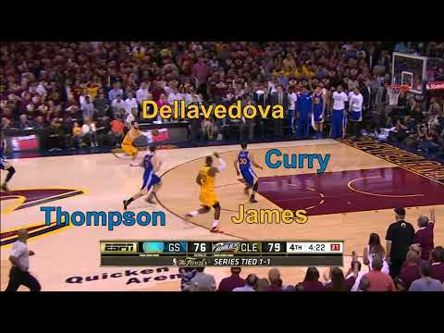
Notes:
This is the 2015 NBA Finals LeBron James dunk we will be analyzing for the rest of the lesson.

Slide 4
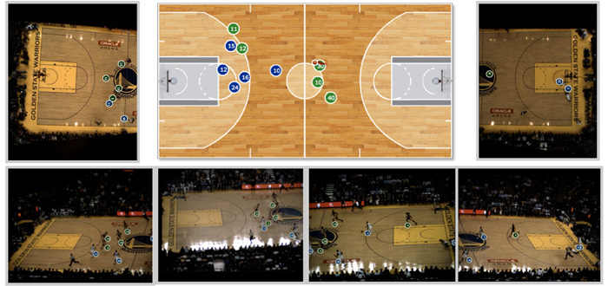
How does the NBA analyze basketball plays?
Notes:
All NBA stadiums have added cameras over the past few years used to track and record the position of players and the ball throughout the game. A computer within the stadium collects the footage from all six cameras and converts the image data to motion tracking data.

Slide 5
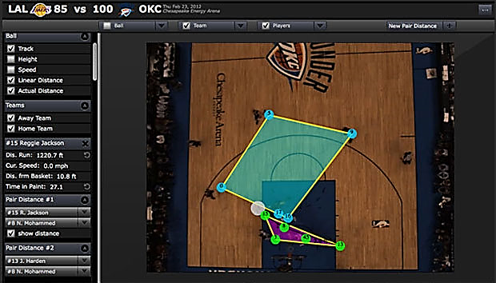
What does the NBA do with that data?
Notes:
The data is used both in real-time to make decisions within the game, and as post-game analysis.

Slide 6

Notes:
Video from Second Spectrum imagining what else could be done with motion tracking data from basketball games

Slide 7
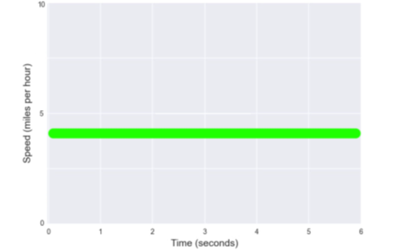
Speed graphs
A speed graph shows how fast someone or something is moving over time
If someone walk at a constant speed for six seconds, what would my speed graph look like?
Notes:
For each of these graphs, act out the walking pattern describe for your students.

Slide 8
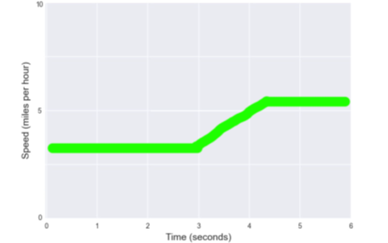
Speed graphs
What if someone starts walking and then gets a little faster… what would the speed graph look like then?

Slide 9
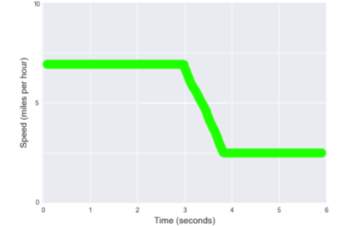
Speed graphs
What if someone starts walking quickly and then slows down?

Slide 10
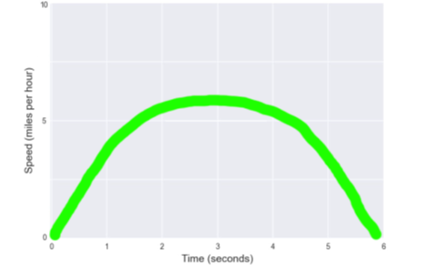
Speed graphs
What if someone speeds up and then slows down?

Slide 11
Practice on the board: speed graphs
I need two volunteers!
Notes:
Ask one student volunteer to act out a walking pattern of their choosing (similar to the previous four slides), and have a second student volunteer draw the resulting speed graph on axes you draw on the board.

Slide 12
How can we get some of that sweet, sweet data?
stats.nba.com – every game, every player, every play
[1610612739,2544,73.05852,16.66766,0.0],[1610612739,2747,48.1481,10.63998,0.0],[1610612739,202697,62.33531,37.34172,0.0],[1610612739,203521,52.17513,30.84171,0.0],[1610612739,202684,67.87185,33.09363,0.0],[1610612744,2738,78.76348,14.36347,0.0],[1610612744,201939,68.4112,30.27713,0.0],[1610612744,203105,76.22807,28.86557,0.0],[1610612744,202691,86.84358,35.99125,0.0],[1610612744,203110,50.60835,7.71326,0.0]]],[4,1433906398077,273.18,23.18,null,[[1,1,86.54056,38.04848,3.86684],[1610612739,2544,72.69043,16.57198,0.0],[1610612739,2747,47.69152,10.67703,0.0],[1610612739,202697,61.84082,37.24552,0.0],[1610612739,203521,51.79007,30.86911,0.0],[1610612739,202684,67.3015,33.07505,0.0],[1610612744,2738,78.43479,14.10021,0.0],[1610612744,201939,67.91246,30.11013,0.0],[1610612744,203105,75.81718,28.76657,0.0],[1610612744,202691,86.48409,36.4047,0.0],[1610612744,203110,50.07952,7.85331,0.0]]],[4,1433906398117,273.14,23.14,null,[[1,1,86.26926,38.48888,4.04632],[1610612739,2544,72.31439,16.48904,0.0],[1610612739,2747,47.22609,10.70228,0.0],[1610612739,202697,61.33983,37.15009,0.0],[1610612739,203521,51.40285,30.8976,0.0],[1610612739,202684,66.72347,33.05276,0.0],[1610612744,2738,78.13155,13.87571,0.0],[1610612744,201939,67.41672,29.93116,0.0],[1610612744,203105,75.38552,28.66771,0.0],[1610612744,202691,86.08634,36.8165,0.0],[1610612744,203110,49.54979,7.99074,0.0]]],[4,1433906398158,273.10,23.10,null,[[1,85.94753,38.64611,3.85551],[1610612739,2544,71.92014,16.40795,0.0],[1610612739,2747,46.76049,10.73014,0.0],[1610612739,202697,60.835,37.06538,0.0],[1610612739,203521,51.01858,30.92559,0.0],[1610612739,202684,66.1406,33.01035,0.0],[1610612744,2738,77.78297,13.61714,0.0],[1610612744,201939,66.92052,29.73793,0.0],[1610612744,203105,74.93824,28.56376,0.0],[1610612744,202691,85.72742,37.20935,0.0],[1610612744,203110,49.0036,8.12453,0.0]]],[4,1433906398198,273.06,23.06,null,[[85.4644,38.97281,3.91678],[1610612739,2544,71.50875,16.32665,0.0],[1610612739,2747,46.28479,10.75911,0.0],[1610612739,202697,60.32086,36.99012,0.0],[1610612739,203521,50.63267,30.94551,0.0],[1610612739,202684,65.55798,32.96765,0.0],[1610612744,2738,77.37693,13.33778,0.0],[1610612744,201939,66.42747,29.53674,0.0],[1610612744,203105,74.49252,28.44727,0.0],[1610612744,202691,85.33998,37.6,0.0],[1610612744,203110,48.44104,8.25653,0.0]]],[4,1433906398237,273.02,23.02,null,[[1,85.10796,39.32459,3.97383],[1610612739,2544,71.08101,16.23399,0.0],[1610612739,2747,45.80118,10.78888,0.0],[1610612739,202697,59.75011,36.91695,0.0],[1610612739,203521,50.23886,30.96152,0.0],[1610612739,202684,64.9796,32.93482,0.0],[1610612744,2738,76.98203,13.08119,0.0],[1610612744,201939,65.91949,29.31403,0.0],[1610612744,203105,74.02528,28.33992,0.0],[1610612744,202691,84.94633,37.95473,0.0],[1610612744,203110,47.86186,8.38104,0.0]]],[4,1433906398277,272.98,22.98,null,[[1,84.53297,39.65517,4.01137],[1610612739,2544,70.63802,16.14399,0.0],[1610612739,2747,45.3138,10.81854,0.0],[1610612739,202697,59.21762,36.85176,0.0],[1610612739,203521,49.85097,30.95068,0.0],[1610612739,202684,64.39081,32.89382,0.0],[1610612744,2738,76.53713,12.79457,0.0],[1610612744,201939,65.40982,29.0857,0.0],[1610612744,203105,73.54548,28.22298,0.0],[1610612744,202691,84.52566,38.31027,0.0],[1610612744,203110,47.29128,8.53681,0.0]]],[4,1433906398318,272.94,22.94,null,[[1,83.72132,39.96997,3.89284],[1610612739,2544,70.18919,16.05757,0.0],[1610612739,2747,44.84167,10.86354,0.0],[1610612739,202697,58.6781,36.78785,0.0],[1610612739,203521,49.46233,30.95916,0.0],[1610612739,202684,63.80207,32.83867,0.0],[1610612744,2738,76.09309,12.50177,0.0],[1610612744,201939,64.88257,28.84614,0.0],[1610612744,203105,73.06605,28.0982,0.0],[1610612744,202691,84.09754,38.67882,0.0],[1610612744,203110,46.70796,8.66474,0.0]]],[4,1433906398358,272.90,22.90,null,[[1,83.06508,40.24343,4.15924],[1610612739,2544,69.74124,15.98498,0.0],[1610612739,2747,44.35027,10.88561,0.0],[1610612739,202697,58.13268,36.72175,0.0],[1610612739,203521,49.07454,30.95927,0.0],[1610612739,202684,63.2166,32.78366,0.0],[1610612744,2738,75.64412,12.21633,0.0],[1610612744,201939,64.3527,28.58547,0.0],[1610612744,203105,72.57927,27.98082,0.0],[1610612744,202691,83.64894,39.00667,0....
Notes:
The data seen on-screen represents way less than a single second’s worth of motion data for one team in one game – reinforce how much data the NBA collects!

Slide 13
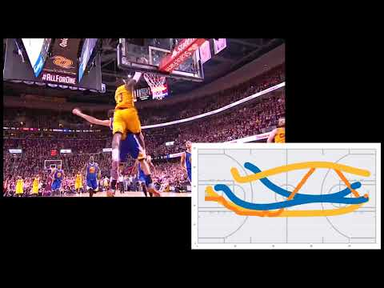
Notes:
With a little bit of code, those numbers can be translated into animated dots moving around an image of a basketball court. Make strong connections for students about how the video relates to the animation – point out when the ball is passed, which players are represented, etc. Right away we’re abstracting out six of the ten players on the court because they’re not as relevant to the play.

Slide 14
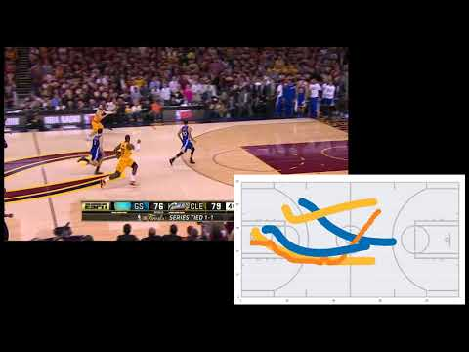
Notes:
This slide slows down the video from the previous slide to ensure all students understand how the video and animation are linked.

Slide 15
What questions do we want to answer?
Who ran the fastest during that play?
How fast was he running?
For how long was he running that fast?
Notes:
These won’t tell us everything about the play, but they are things we can answer using the motion tracking data we have.

Slide 16
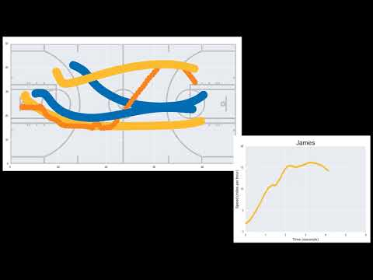
Notes:
Looking at just LeBron James’ speed graph from the same play. LeBron is the lower of the yellow lines, starting with the ball on the rebound.

Slide 17
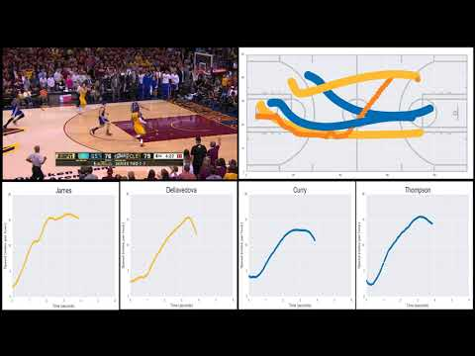
Notes:
Putting everything together – showing all four players’ speed graphs at once.

Slide 18

Notes:
Slowing it down again.

Slide 19
Again, what questions do we want to answer?
Who ran the fastest during that play?
How fast was he running?
For how long was he running that fast?
Notes:
Quick review of the questions we want to answer with this data.

Slide 20
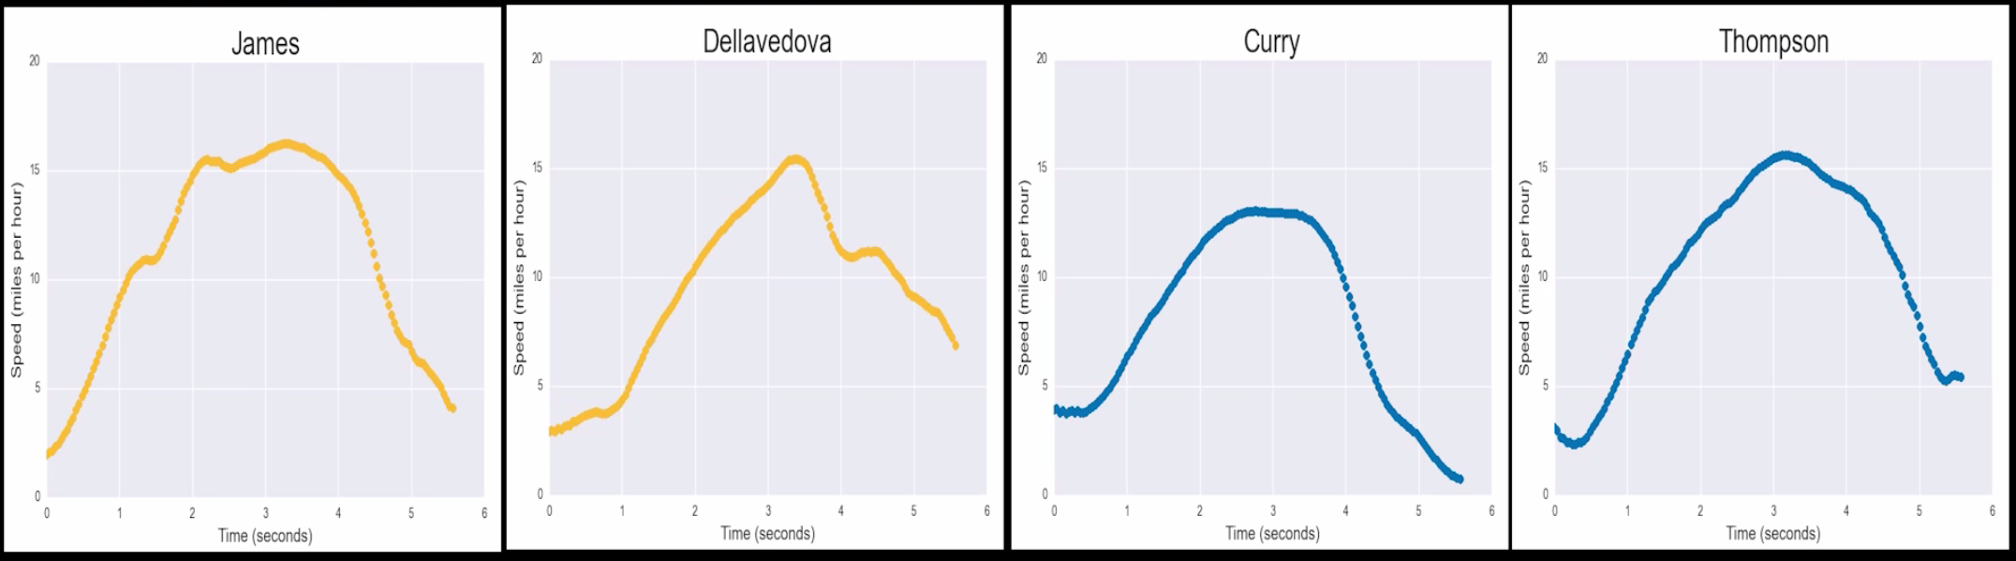
Let’s go to the speed graphs!
LeBron James
Who ran the fastest during that play?
Notes:
Students may already be jumping to explain that LeBron’s speed wasn’t necessary the biggest factor in this play, which is great. Let students try to guess why Steph Curry seems to have stopped so early in the play – they may think he got tired or gave up, but really he was stopping because he was already at the end of the court and had nowhere to go.

Slide 21
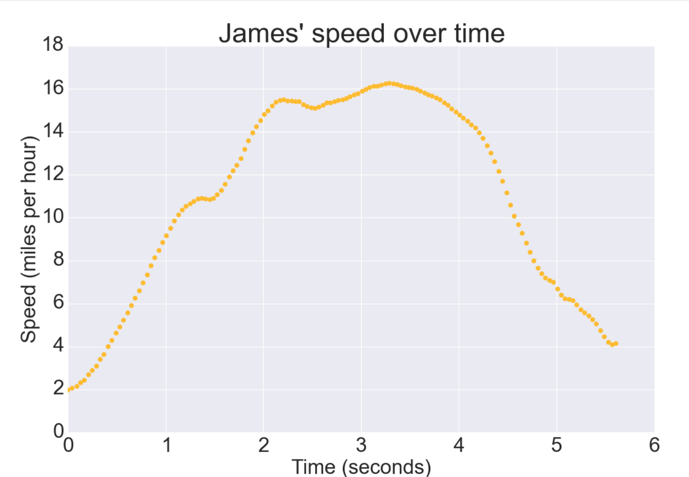
A closer look at LeBron’s graph
2. How fast was he running?
3. For how long was he running that fast?
16 miles per hour
About half a second
Notes:
Students practice reading the actual speed from the graph (not just understanding the general shape), and then pinpoint when and how long he was at that max speed.

Slide 22
Now it’s your turn!
Notes:
At this point, pass out the worksheet for independent or partner practice time.

